Slide 1
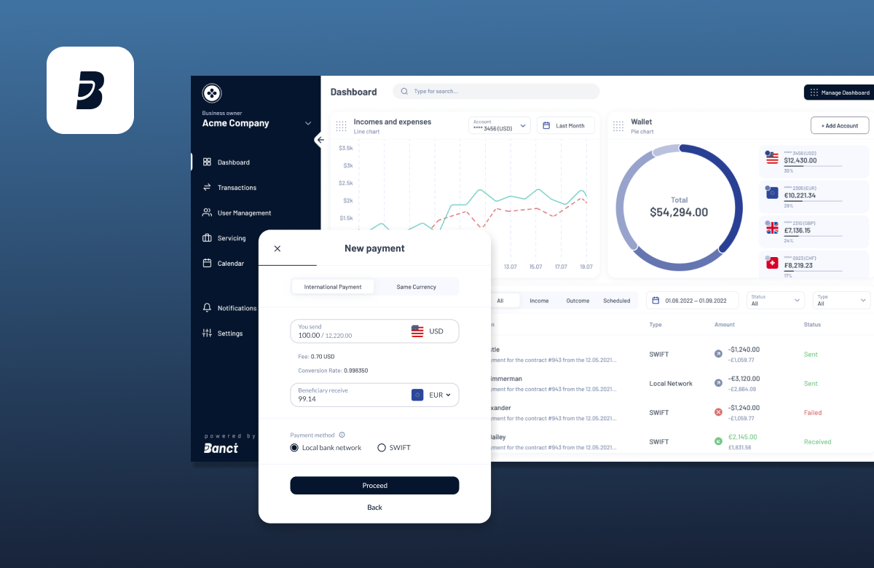




Enterprise-Grade Digital Lending Platform
UNISOFT LOAN
MANAGEMENT SYSTEM
Comprehensive Digital Lending Platform for Bangladesh's Banking Sector
85% Faster Processing
100% BB Compliance
95% Faster Decisions
80-90% Cost Advantage

Slide 2
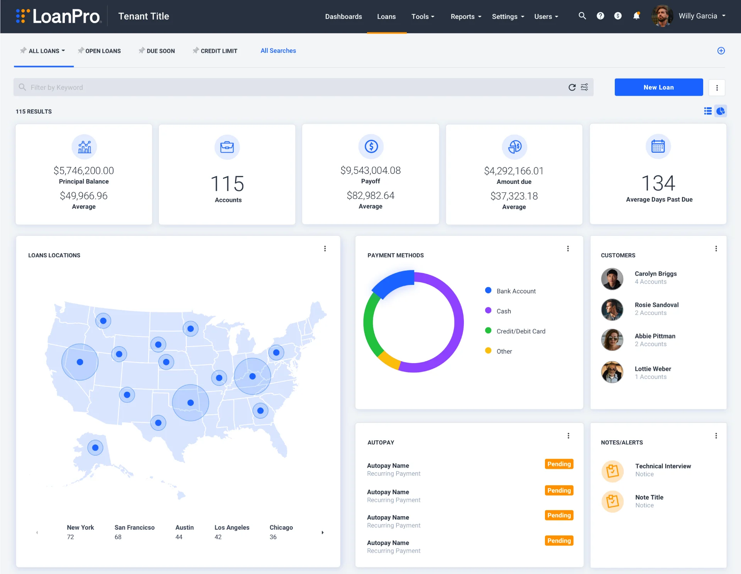







Executive Summary
Digital Banking Revolution
ULMS vs. International Solutions
Target: 75% Cashless Transactions by 2027
Mandatory: IFRS-9 ECL by Dec 2027
85%
95%
Faster Processing
Faster Decisions
7-15 days → <48 hrs
3-5 days → <30 mins
100% Bangladesh Bank Compliant
90%
80-90%
Error Reduction
Cost Advantage
5-10% → <1%
vs. International

Slide 3
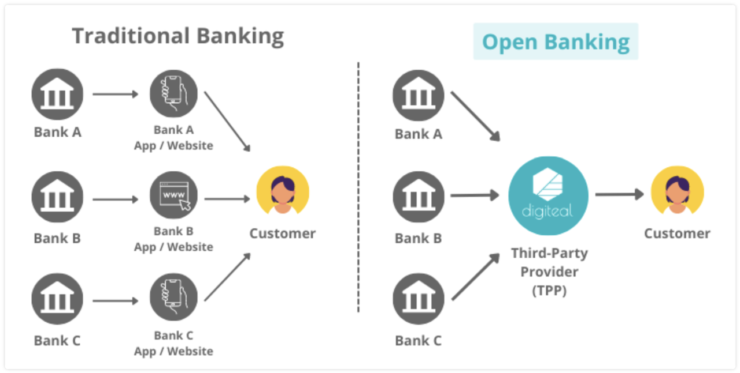
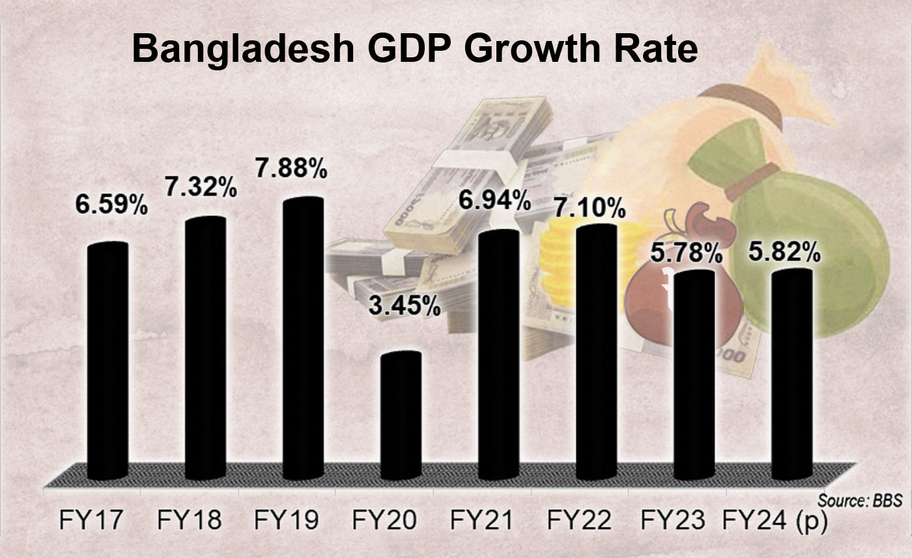







Bangladesh Banking Context
Market Overview
GDP Growth Trend
62
170M
Scheduled Banks
Population Served
Digital Banking Roadmap 2025-2027
75% Cashless Transactions
2027
IFRS-9 ECL Provisioning
Dec 2027
Digital Transformation Imperative
Bangladesh's banking sector requires modern, compliant, and scalable Loan Management Systems to meet regulatory mandates and customer expectations.
Inclusive Instant Payment System
July 2027
AI Policy Compliance
2026

Slide 4
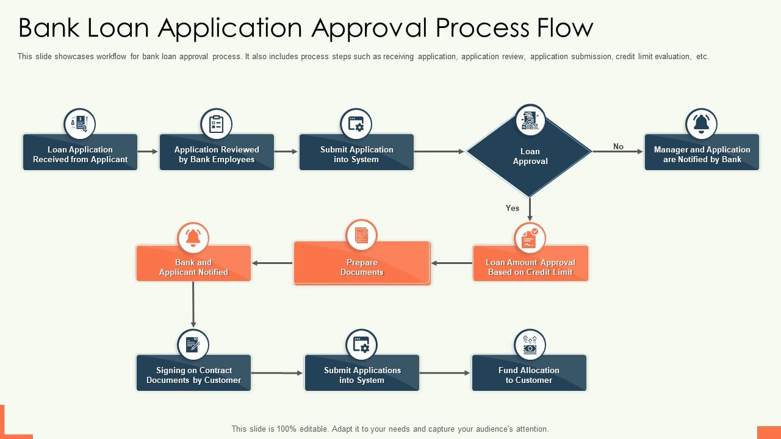












Current Challenges
Traditional Loan Management Pain Points
Impact Summary
Slow Processing
High Error Rates
7-15 days turnaround
5-10% error rate
Customer Experience Gap
Lengthy approval process causes frustration
CIB Delays
No Visibility
Operational Inefficiency
30-60 minutes per loan
Status tracking absent
Manual workflows reduce productivity
Reactive NPA
Manual Reports
Compliance Risks
Delayed identification
2-3 hours preparation
Manual preparation leads to errors
High Operational Costs
Communication Delays
Paper-based processes increase expenses
File movement between branch and head office

Slide 5
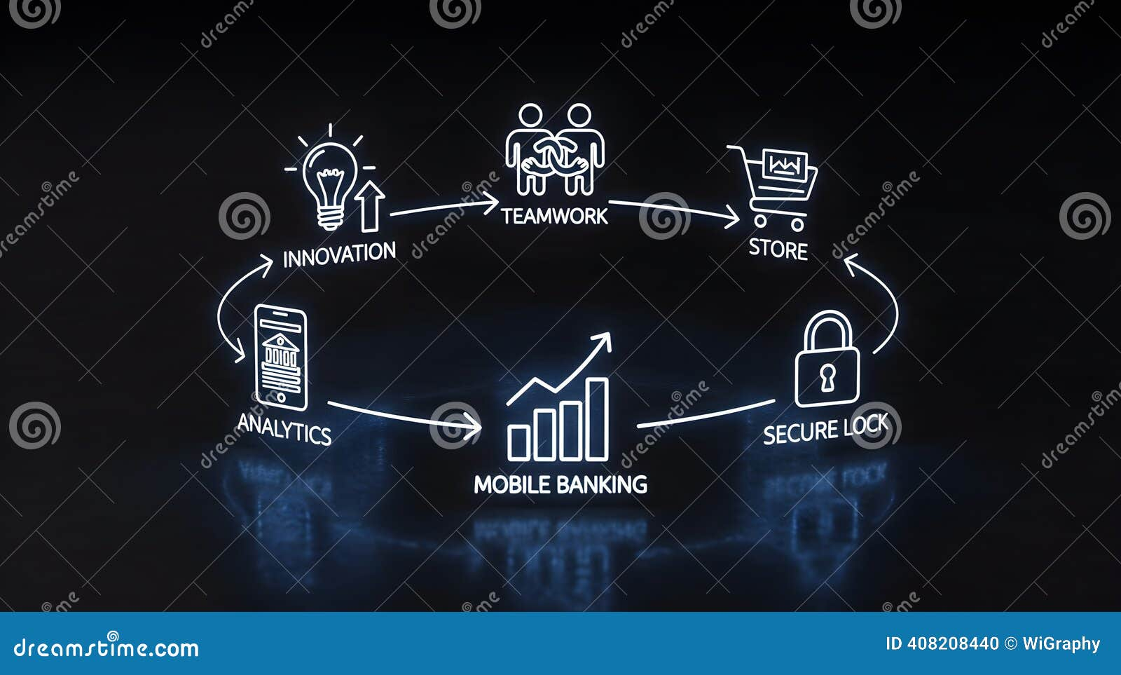








Background of Loan Management Systems
Phase 1: Manual Era
10-15% Error Rate
Bangladesh Context
Pre-2000s
62
Scheduled Banks
Phase 2: Basic Automation
2000-2010
170M
Population Served
Phase 3: Integrated Systems
Digital Roadmap 2025-2027
2010-2020
75% Cashless Transactions
IFRS-9 ECL Mandatory
Phase 4: AI-Powered Digital Lending
2020-Present
Digital Bank Licensing

Slide 6
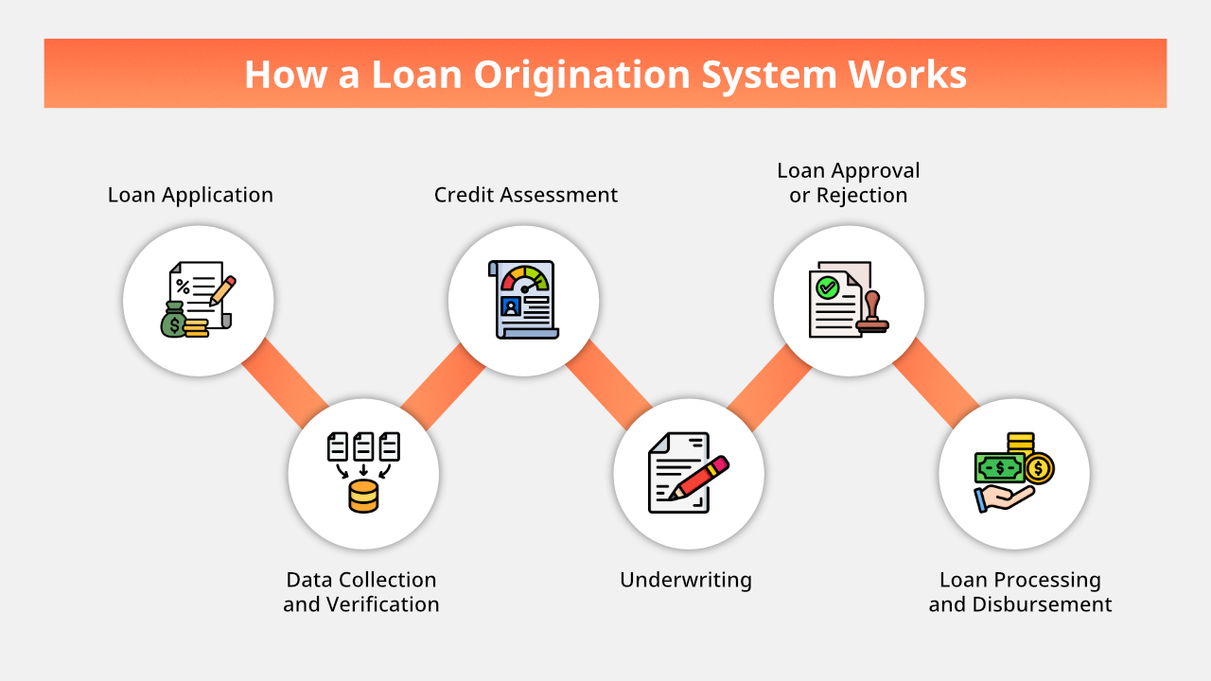











How Banks Normally Manage Loan Processes
Stage 1: Customer Requisition
Current Challenges
Branch Level • 1-2 days
7-15 days turnaround
Stage 2: BOCC Review
All loans
Committee Meeting • 2-3 days
5-10% error rate
High frequency
Stage 3: Credit Analysis
30-60 minutes CIB
CIB Inquiry & Assessment • 3-5 days
Every loan
Stage 4: HO Approval
No status tracking
Multi-Level Review • 2-4 days
Customer visibility
Stage 5: Disbursement
Total Processing Time
Security Creation & Payment • 2-3 days
17-29
Stage 6: Servicing & Collection
Days Average
Ongoing Monitoring & Follow-up

Slide 7
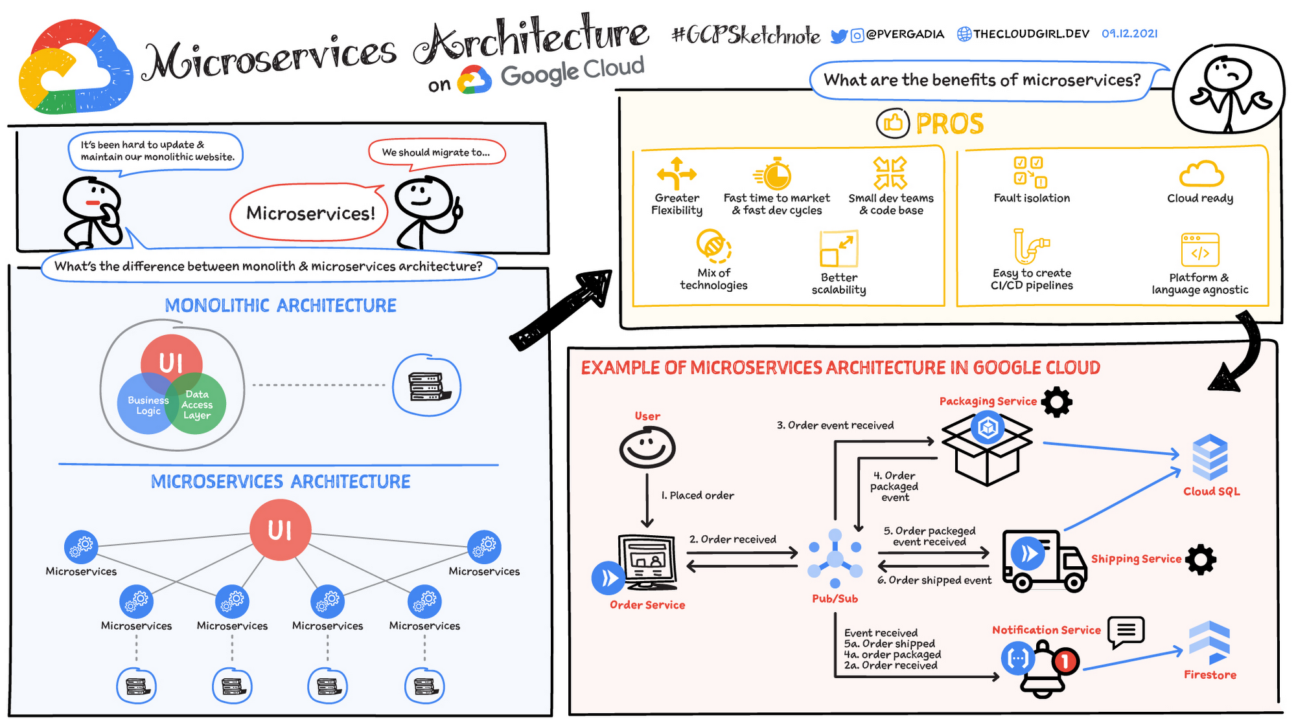










ULMS Product Overview
Enterprise-Grade Architecture
Product Editions
Presentation Layer
ULMS Standard
Web Portal • Mobile App • Customer Portal • Reporting Dashboard
Small-Medium Banks • 1-50 Branches
API Gateway Layer
Authentication • Authorization • Rate Limiting • Routing
ULMS Enterprise
Large Banks • 50+ Branches
Business Services Layer
Customer • Loan • Credit • Collection • Document • Workflow • Product • Accounting • Reporting • Compliance
ULMS Islamic
Shariah-Compliant Banking • Any Size
Integration Layer
CBS • CIB • NID/eKYC • AML • Payment Gateway
ULMS Digital
Digital Banks/Fintechs • Virtual-First
Data Layer
PostgreSQL • Read Replicas • Encrypted Document Storage
Regulatory-First Architecture • API-First Design • Cloud-Ready Scalability

Slide 8
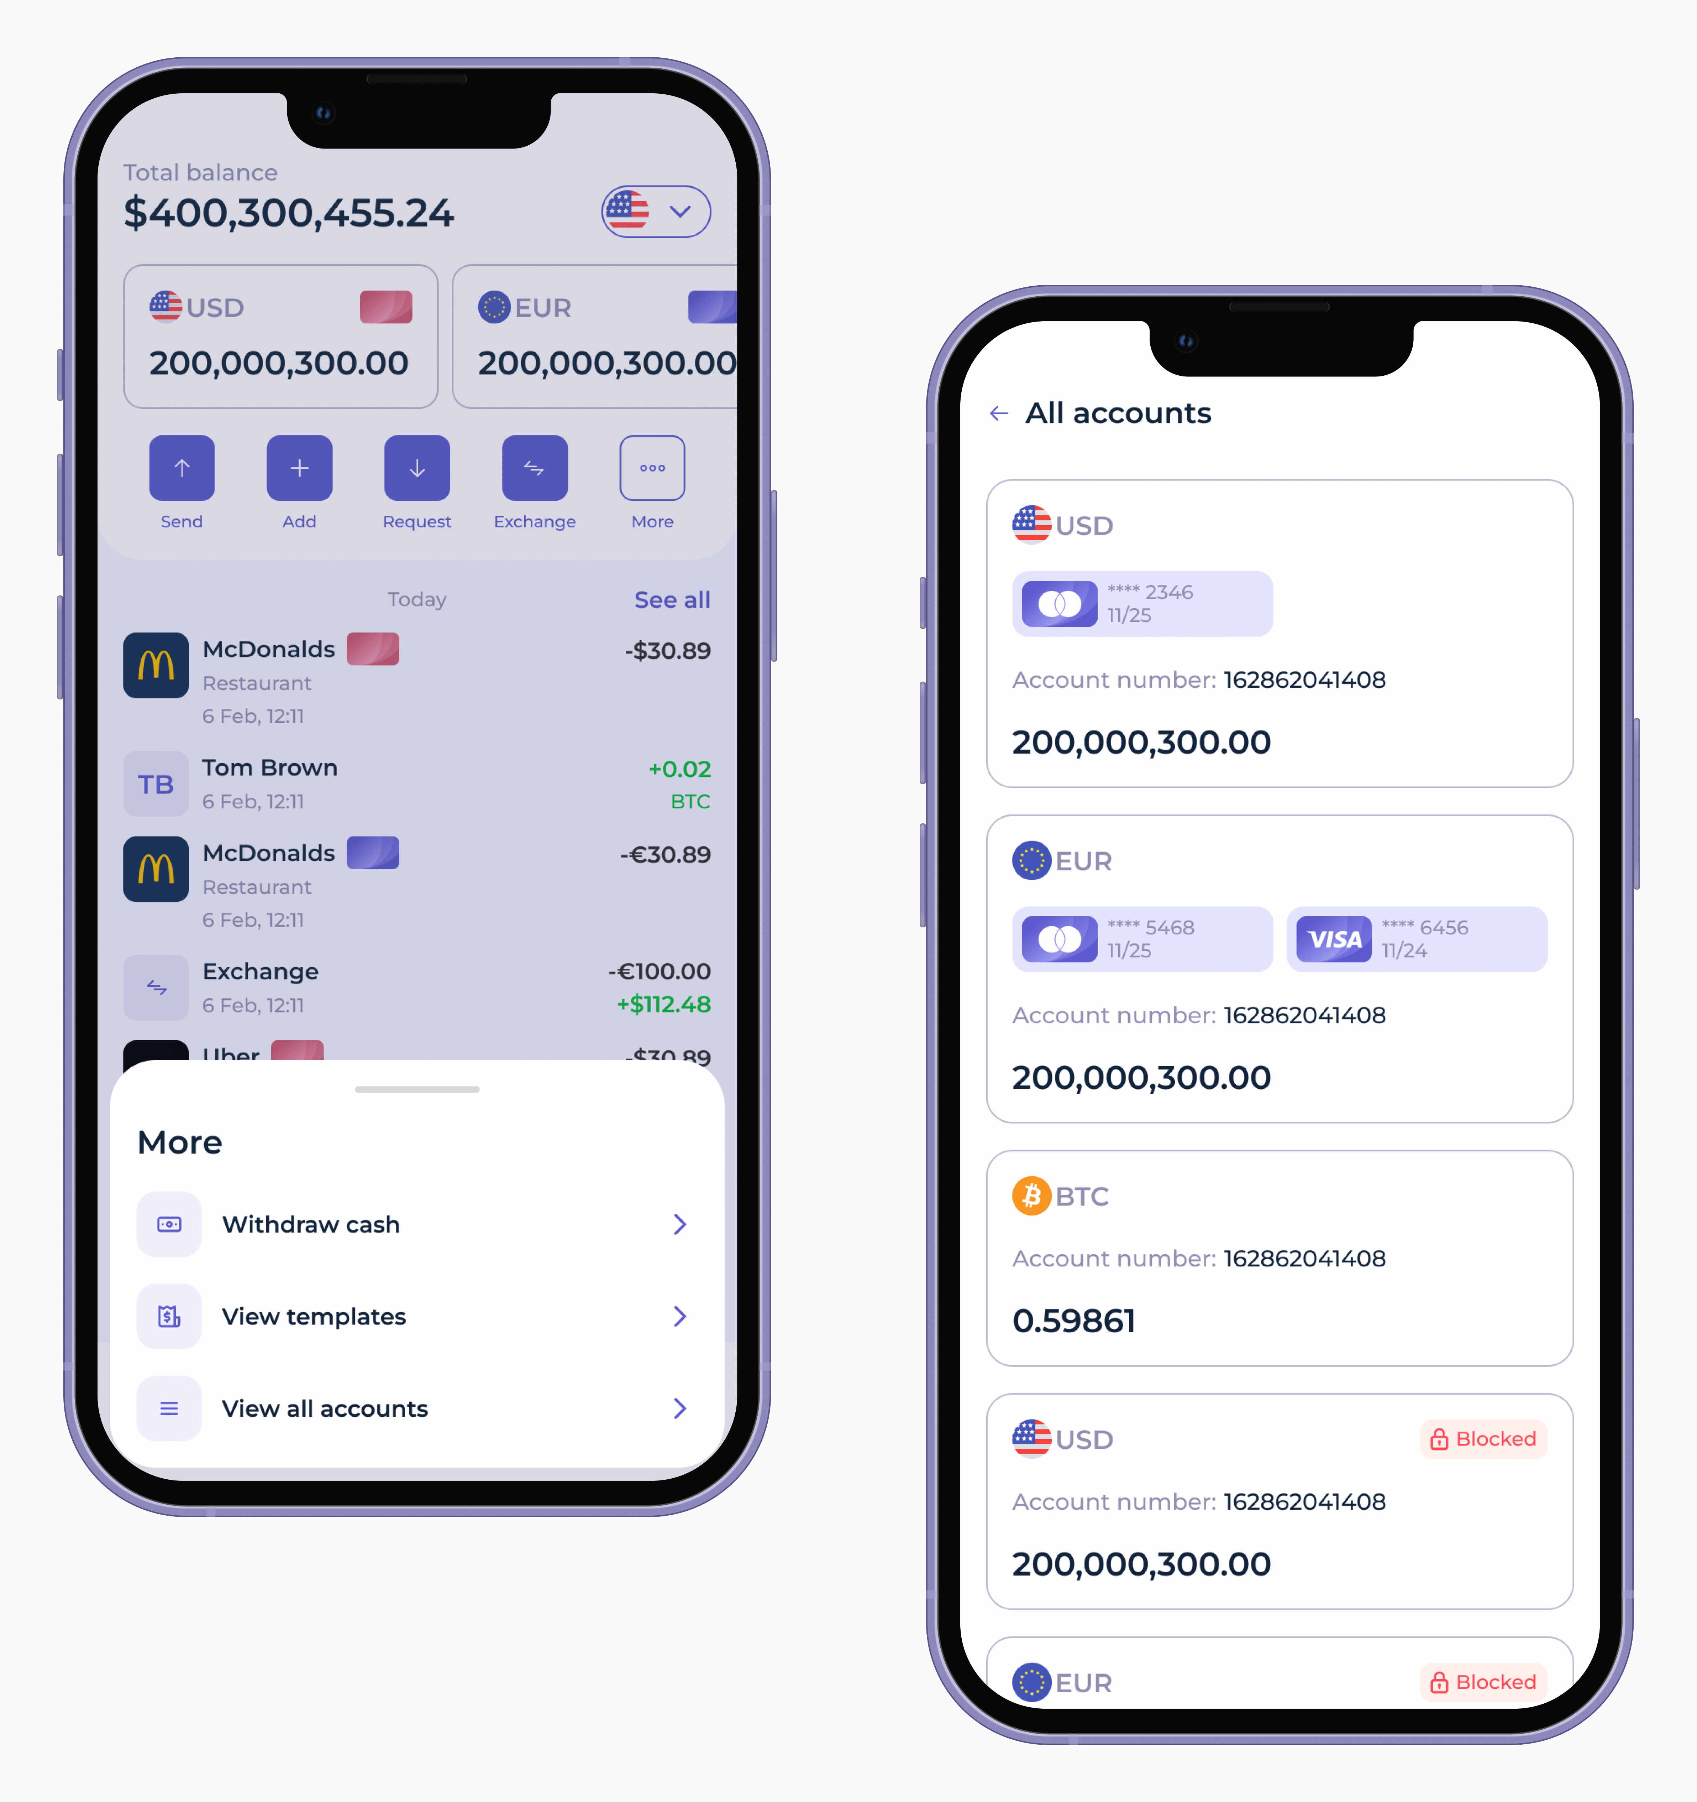

















Key Features: Loan Origination
Digital Channels
e-KYC Integration
Web Portal
Branch Console
NID Verification
Biometric Check
Mobile Field
API Gateway
OCR Processing
Address Validation
BOCC Module
Document Management
Meeting Scheduler
Document Checklist
Agenda Management
Version Control
Digital Signatures
AES-256 Encryption

Slide 9
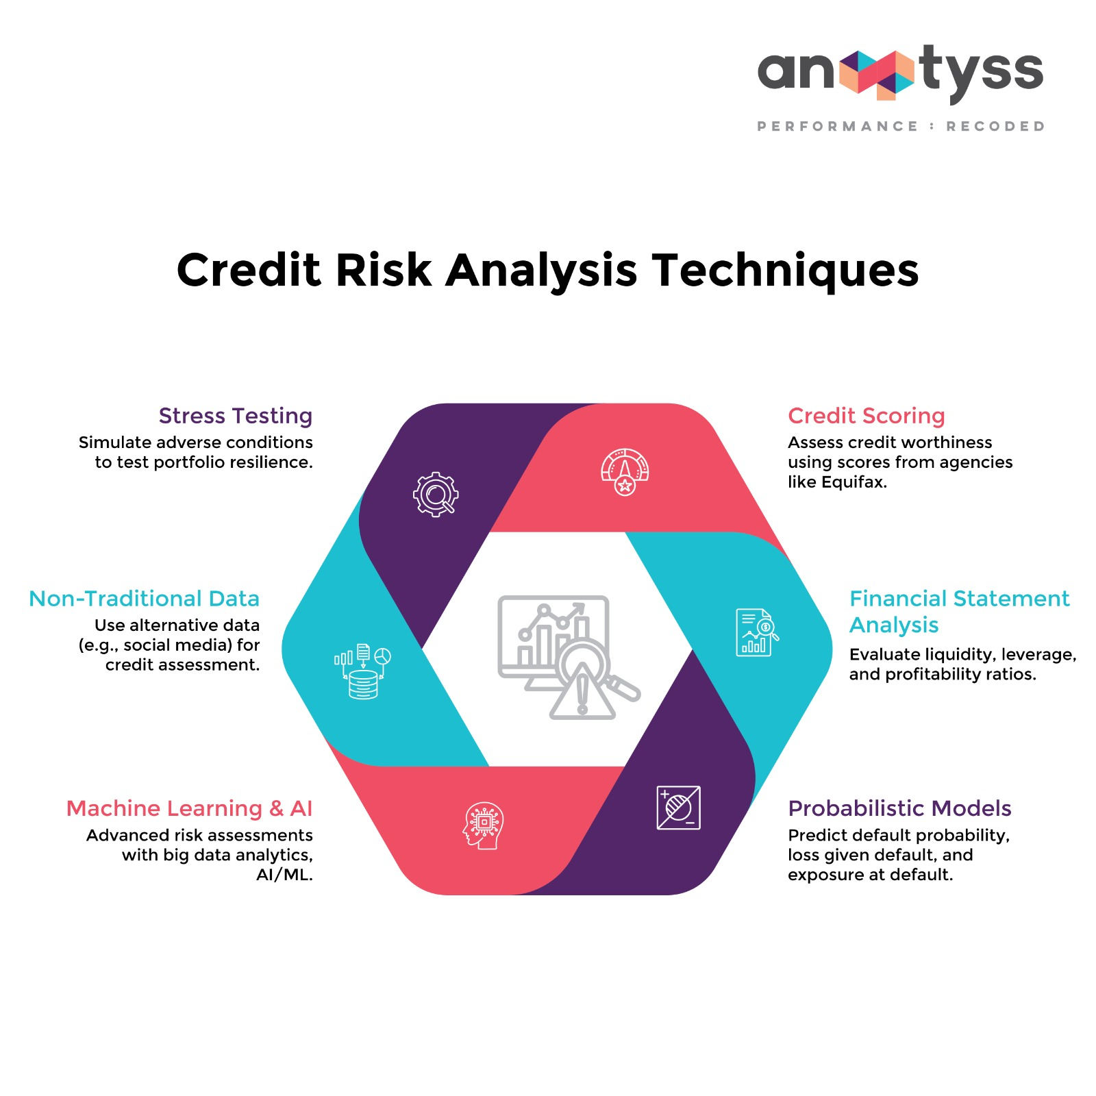



















Key Features: Credit Management
Credit Scoring Engine
CIB Integration
Customer Profile
20%
Real-Time Online Inquiry
30%
Individual & Corporate Reports
Financial Capacity
Automated Score Interpretation
Credit History
25%
Collateral Security
15%
Contact Point Verification
Industry Risk
10%
Mobile App
GPS Tagging
DBR/DTI Calculation
Photo Capture
Digital Signatures
DBR < 50%
DTI < 40%
EMI/Income
Debt/Income
95% Faster Decisions • Instant Credit Assessment

Slide 10
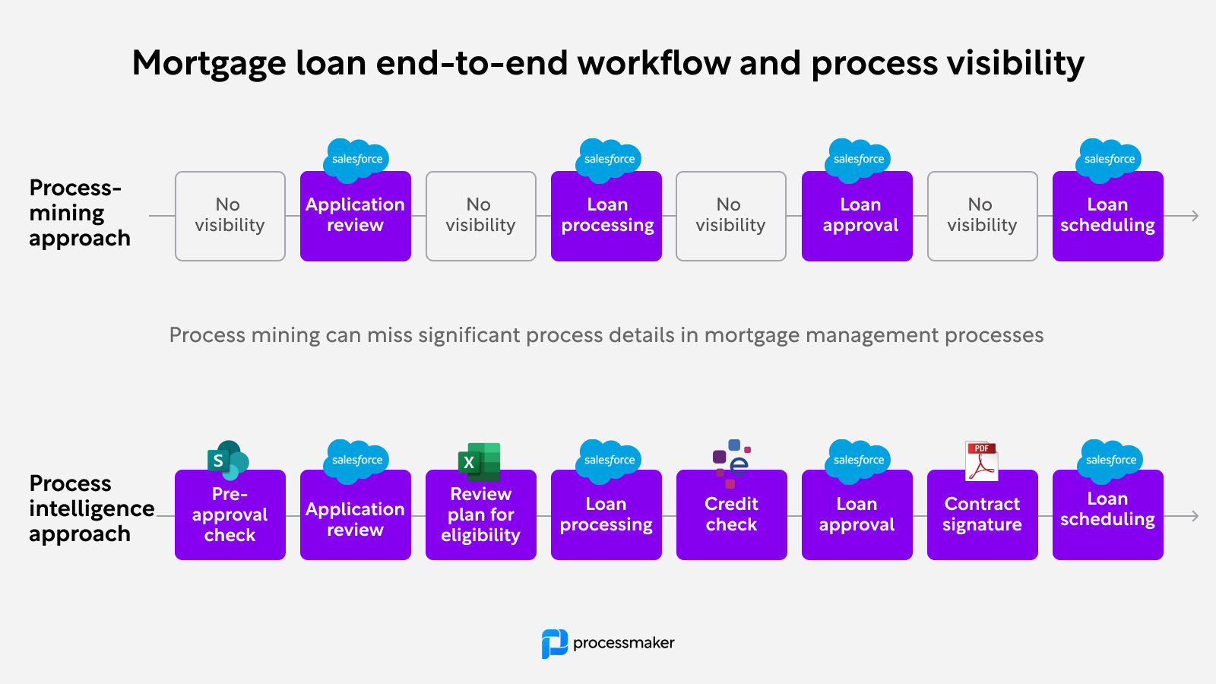

















Key Features: Approval & Disbursement
7-Level Approval Hierarchy
Disbursement Methods
Branch Credit Head
5 Lakh BDT
Account Credit
BEFTN Transfer
Branch Manager
10 Lakh BDT
Regional Manager
25 Lakh BDT
bKash
Nagad
Head of Credit
1 Crore BDT
Credit Committee
5 Crore BDT
Rocket
Check Payment
Deputy MD
10 Crore BDT
Managing Director
Above 10 Cr
Sanction Letter
Auto-Generation
Workflow Features
Customizable Templates
Configurable Limits
Parallel Processing
Email/SMS Delivery
Escalation Rules
Delegation
Acceptance Tracking
Conditional Approval
Digital Signatures
70% Faster Approval • Same-Day Disbursement

Slide 11
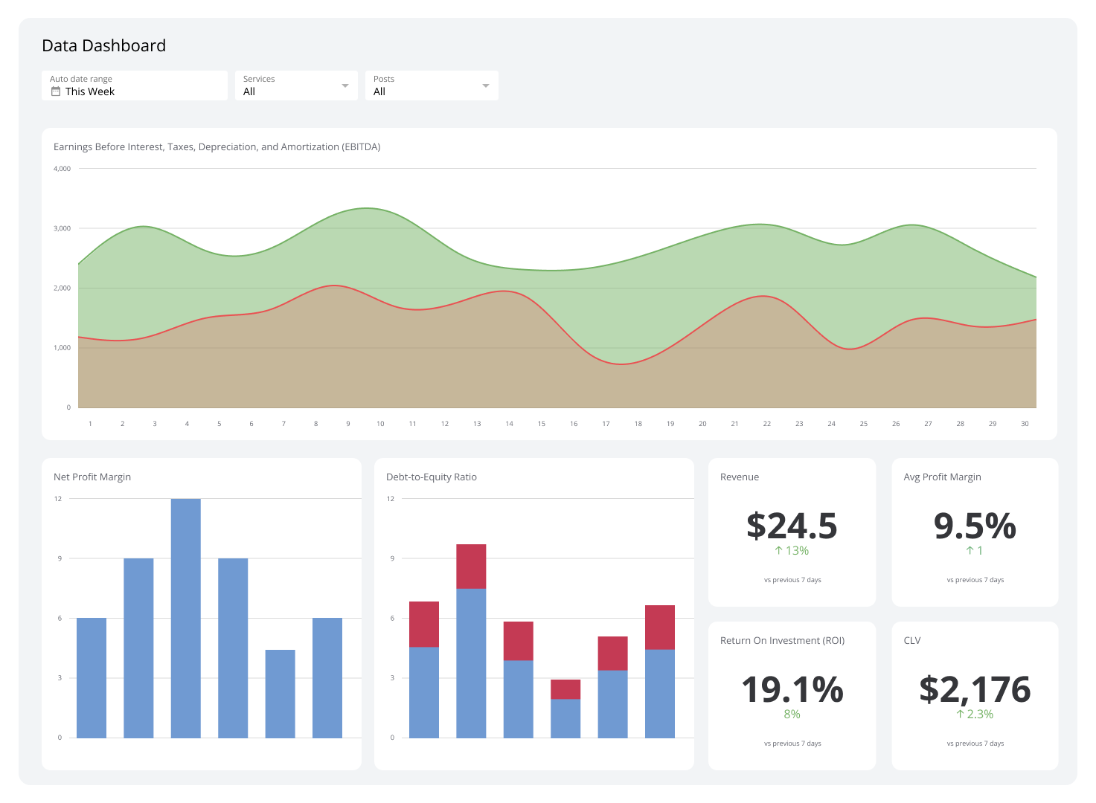



























Key Features: Servicing & Collection
Repayment Management
NPA Management (BRPD 15/2024)
EMI Calc
Multi-Mode
Prepayment
Auto Classification
Provisioning Calc
Write-off Process
Recovery Track
Account Management
Statements
Balance Inquiry
Collection Workflow
Transaction History
Interest Calc
DPD Tracking
Auto Reminders
Loan Modifications
Field Visits
Recovery Track
Rescheduling
Restructuring
Top-up
Rate Change
Tenor Change
Moratorium
100% BRPD 15/2024 Compliant
15% Better Recovery

Slide 12



















Product Configuration
Retail Loan Products
Islamic Banking Products
Personal Loan
Home Loan
Murabaha
50K-10L BDT • 12-60 months
10L-3Cr BDT • 5-20 years
Cost-plus financing
Auto Loan
Education Loan
Ijara
5L-1Cr BDT • 1-5 years
50K-20L BDT • 1-7 years
Leasing contract
Consumer Durable
Credit Card
Musharaka
Joint venture partnership
SME/Commercial Products
Mudaraba
Profit-sharing partnership
Working Capital
Term Loan
Istisna
Trade Finance
Project Finance
Manufacturing finance
Lease Finance
Bai-Muajjal
Deferred sale financing
Configurable Parameters: Amount, Tenor, Interest, Repayment, Charges, Security

Slide 13
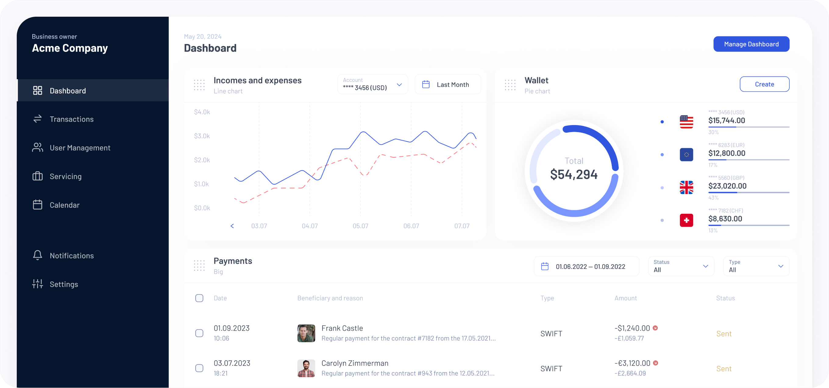




















Analytics & Reporting
Real-Time Dashboards
Regulatory Reports
Portfolio Overview
Application Pipeline
CL-1 Report
Classified Loans
Disbursement Trends
Collection Efficiency
NPA Analysis
Product Performance
CL-2 Report
Provisioning Details
CL-3 Report
Recovery Position
CL-4 & CL-5
Write-off & Restructured
Additional Compliance
CIB Submission
Basel III Report
Operational Reports
NPA Report
Provisioning Report
Loan Ledger
Disbursement
Repayment
Overdue
Aging
PAR
Real-Time Reports
100% Compliant

Slide 14
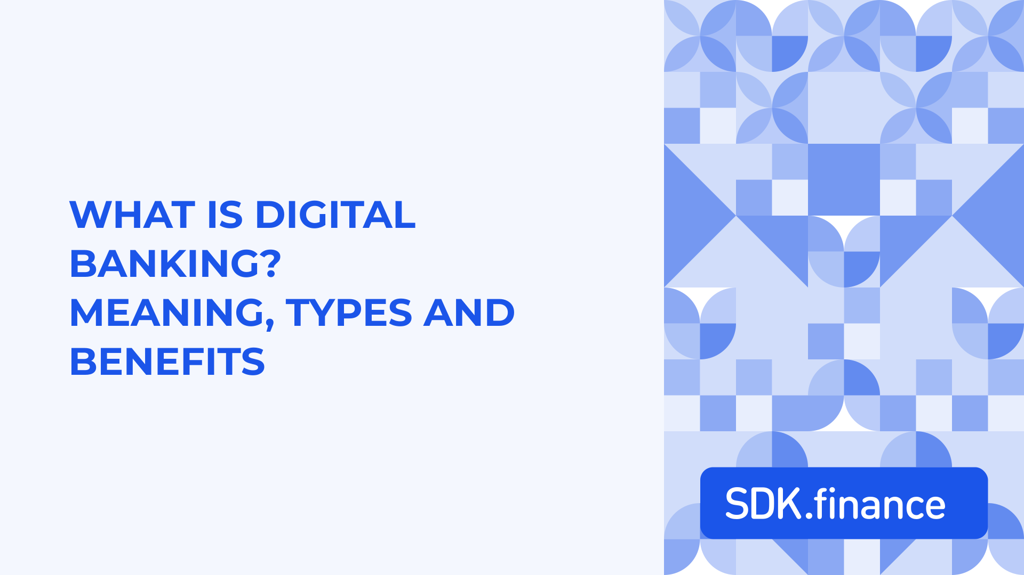













Business Solutions
Digital Transformation
Operational Efficiency
End-to-end digital workflow
85% faster
7-15 days → <48 hrs
Loan Processing
85% faster
Digital document management
80% cost ↓
AI-powered credit scoring
95% faster
3-5 days → <30 mins
Automated collections
15% better
Credit Decisions
95% faster
Data Entry Errors
5-10% → <1%
90% ↓
CIB Inquiry
30-60 mins → <2 mins
95% faster
Regulatory Compliance
2-3 hrs → Real-time
Report Generation
95% faster
BRPD 15/2024
CIB Reporting
Basel III
IFRS-9 ECL
AML/KYC Integration
Complete Digital Transformation
40% Productivity ↑

Slide 15
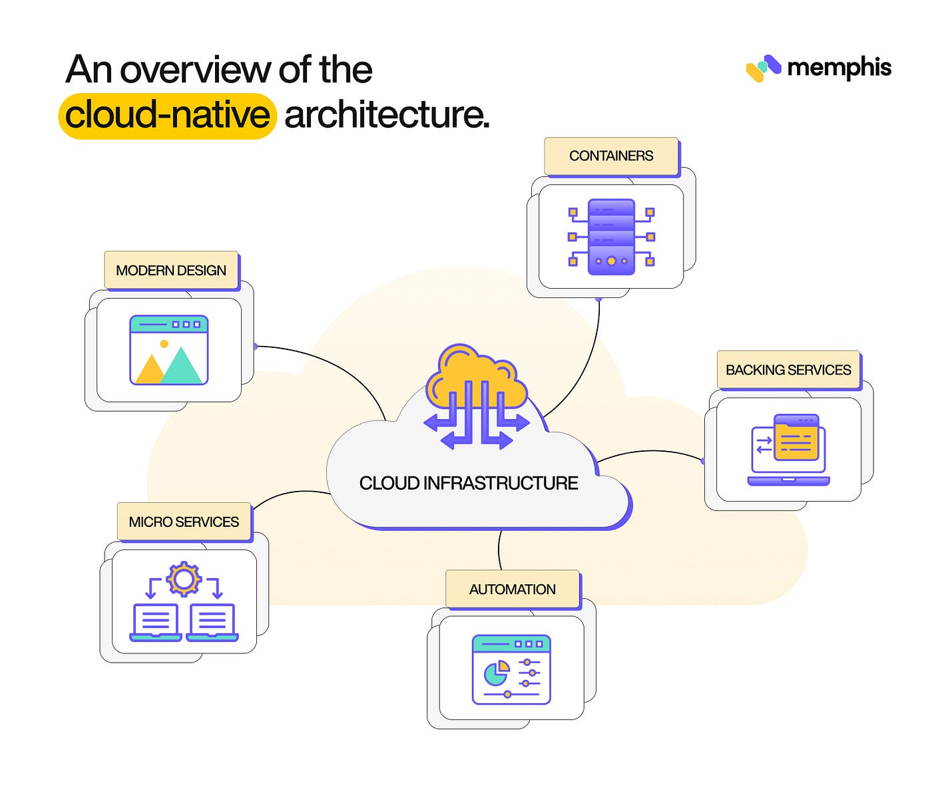











Scalability & Future-Proof Architecture
Scalability Features
Future-Proof Capabilities
Horizontal Scaling
Modular Architecture
Product Plugins
Database Scaling
Integration Connectors
Workflow Extensions
10K+
1K+
99.9%
Report Templates
API Extensions
Daily Apps
Concurrent
Uptime
Capacity Planning
Performance Benchmarks
Small
1-10 branches
API Response
Page Load
DB Queries
<500ms
<2s
<100ms
Medium
11-50 branches
Large
51-100 branches
Very Large
100+ branches

Slide 16
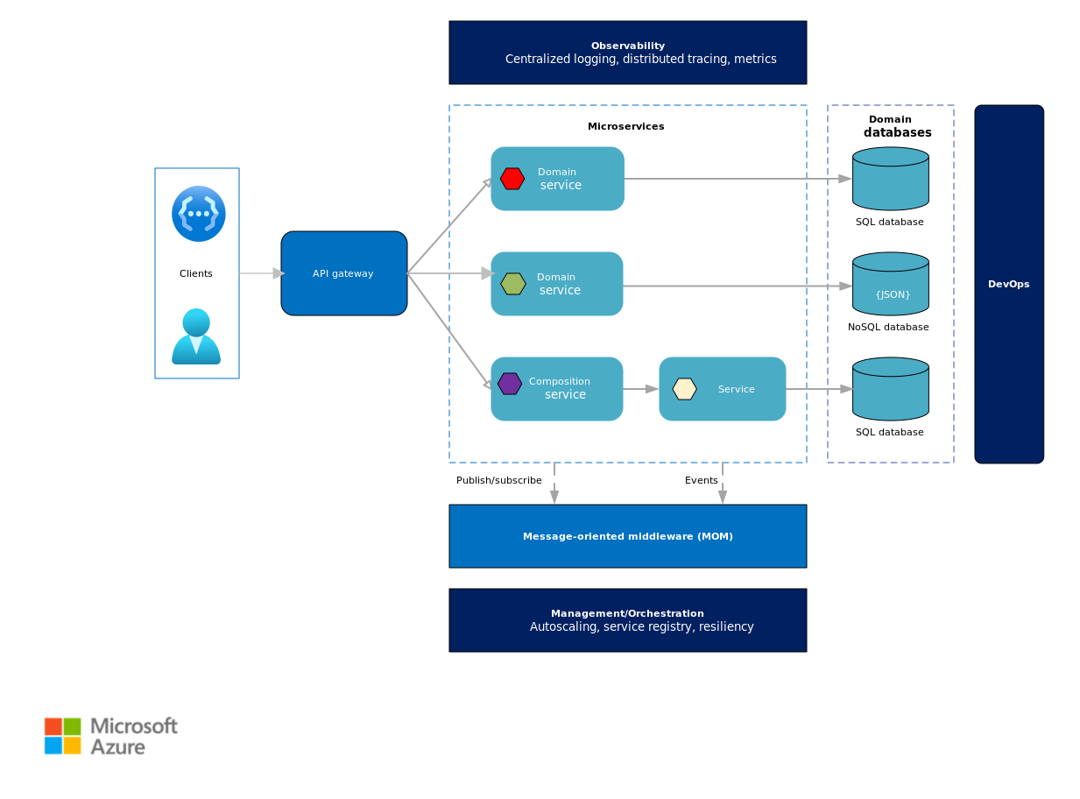
















Technology Architecture
Microservices Architecture
Event-Driven Architecture
Independent Scaling
High Resilience
Real-Time Notifications
Technology Diversity
Flexibility
Decoupled Systems
10 Core Services
Improved Scalability
• Customer
• Loan
Audit Trail
• Credit
• Collection
• Document
• Workflow
• Accounting
• Reporting
Scalability & Performance
• Integration
• Notification
Daily Applications
10,000+
API-First Design
API Response Time
<500ms
Total APIs
150+
System Uptime
99.9%
25+
40+
20+
Customer
Loan
Credit
15+
30+
20+
Collection
Reporting
Admin
Future-Proof Architecture
Horizontally Scalable

Slide 17
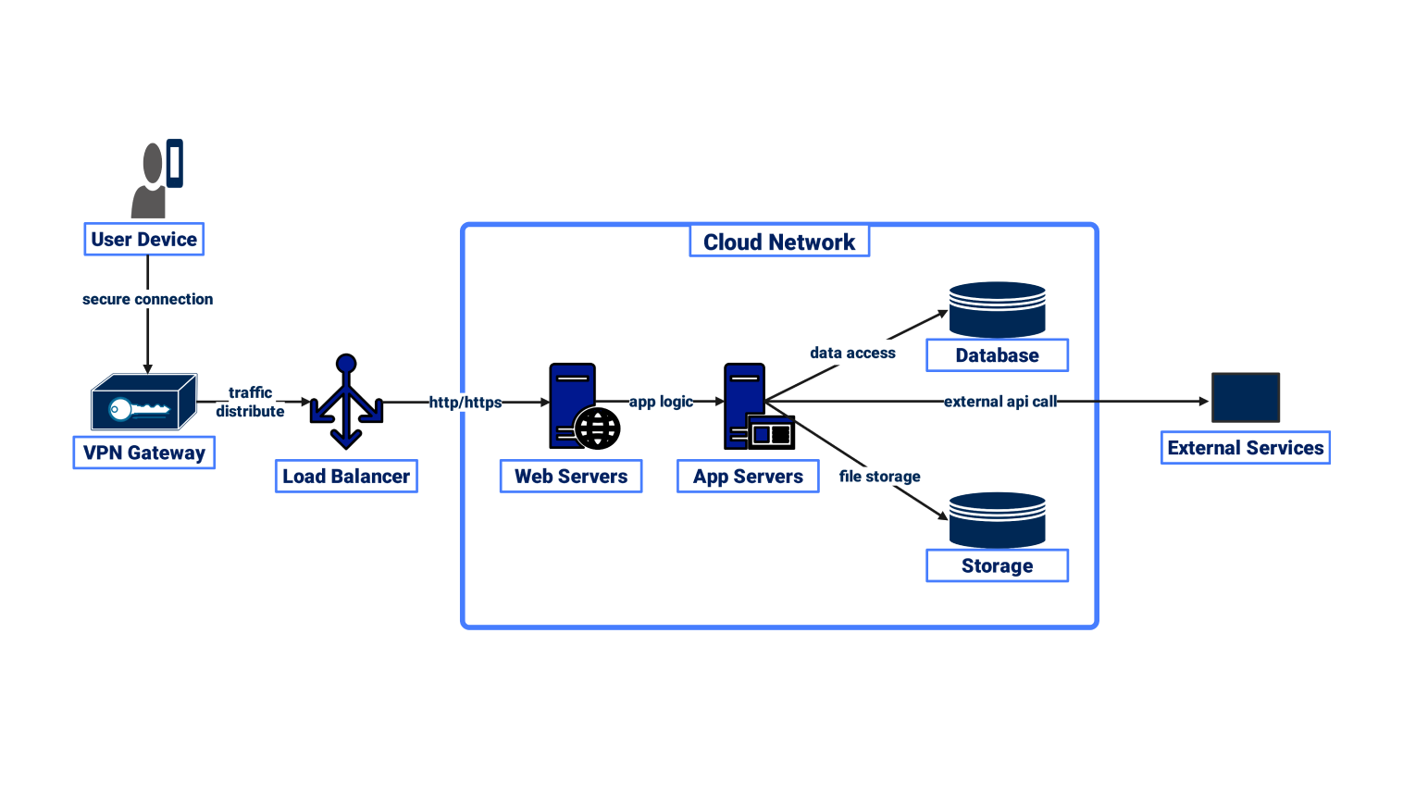











Technology Stack
Frontend
DevOps & Infrastructure
React.js 18+
Redux Toolkit
Material-UI
Docker
Kubernetes
GitLab CI/Jenkins
React Form Hook
Recharts
React Native
Terraform
Prometheus
ELK Stack
Backend
Java Spring Boot 3.x
Java 17 LTS
Security
Spring Security 6.x
Quartz Scheduler
RabbitMQ 3.12+
SpringDoc OpenAPI
OAuth 2.0/JWT
AES-256 Encryption
TLS 1.3
ModSecurity WAF
Database
PostgreSQL 15+
Read Replicas
Redis 7+ (Cache)
Elasticsearch 8+
Enterprise-Grade Technology
Future-Proof

Slide 18














Pain Points & Solutions
Operational Pain Points
Compliance Pain Points
Slow Loan Processing
7-15 days
Manual Classification
Auto Engine
<48 hrs
Provisioning Errors
Auto-Calc
Manual Credit Assessment
3-5 days
<30 mins
CIB Reporting Delays
Batch API
High Error Rates
5-10%
Regulatory Report Burden
One-Click
<1%
Document Management Chaos
Encrypted DMS
Comprehensive Solutions
Technology Pain Points
85%
95%
90%
Faster Processing
Faster Decisions
Error Reduction
Limited Integration
API-First
Manual Reporting
2-3 hours
Real-time
No Real-Time Data
Event-Driven

Slide 19
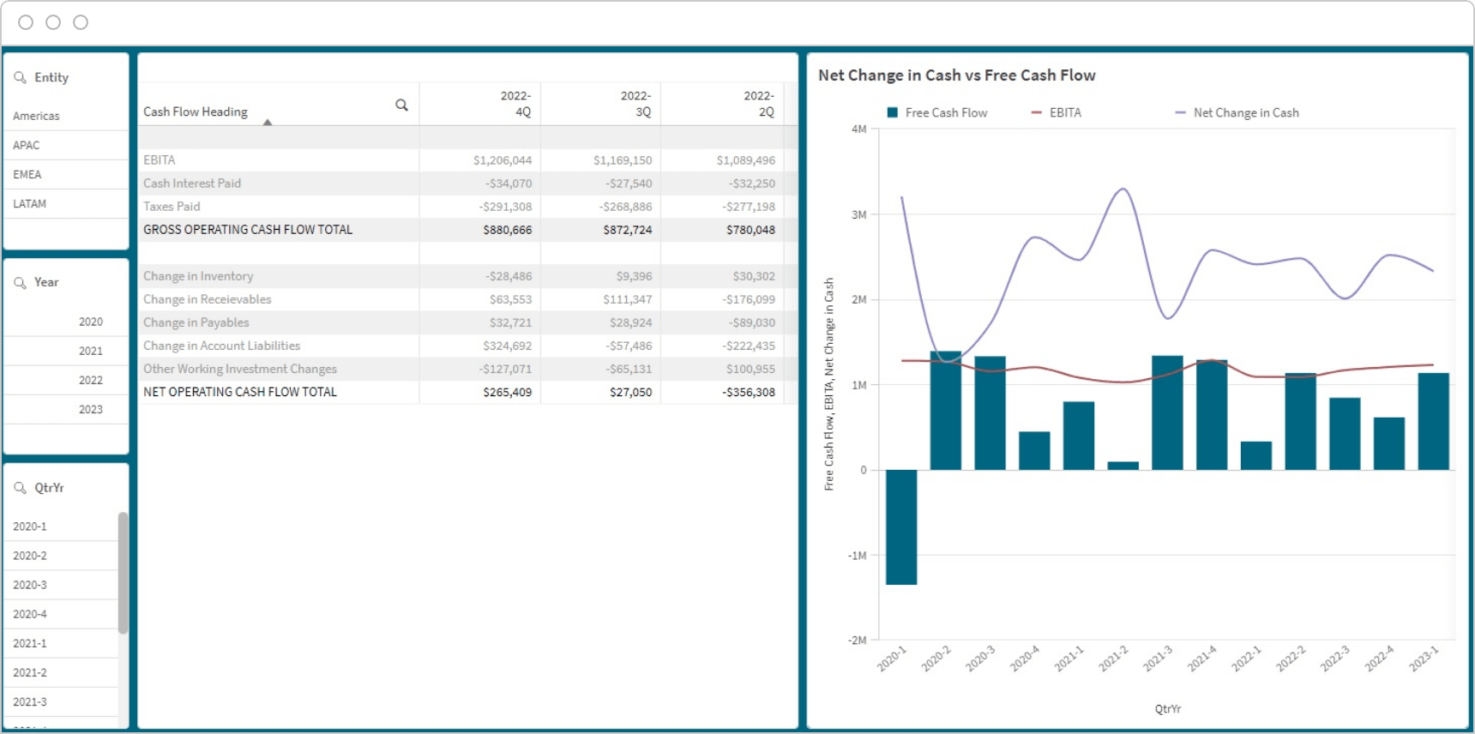












Operational Benefits
Key Metrics
Process Automation Impact
Loan Processing
85% Faster
Application Intake
Credit Inquiry
7-15 days → <48 hrs
60% Faster
95% Faster
Credit Decisions
95% Faster
3-5 days → <30 mins
Credit Scoring
Approval Workflow
Data Entry Errors
90% ↓
Instant
70% Faster
5-10% → <1%
CIB Inquiry
95% Faster
Disbursement
Collection
30-60 mins → <2 mins
Same-Day
15% Better
40% Productivity Improvement
Enhanced Staff Efficiency

Slide 20
















Bangladesh-Specific Compliance
Regulatory Framework
BRPD 15/2024
CIB Reporting
Digital Banking Roadmap 2025-2027
Auto Loan Classification
Online Inquiry
75% cashless transactions
Provisioning Calculation
Batch File Submission
IFRS-9 ECL Mandatory
NPA Reporting
Score Interpretation
By December 2027
Digital Bank Licensing
Basel III
IFRS-9
BDT 300 crore capital
RWA Calculation
ECL Calculation Engine
Instant Payment System
Capital Adequacy Reporting
Forward-Looking Info
By July 2027
AML/KYC Integration
e-KYC
NID DB
Biometric
AML

Slide 21
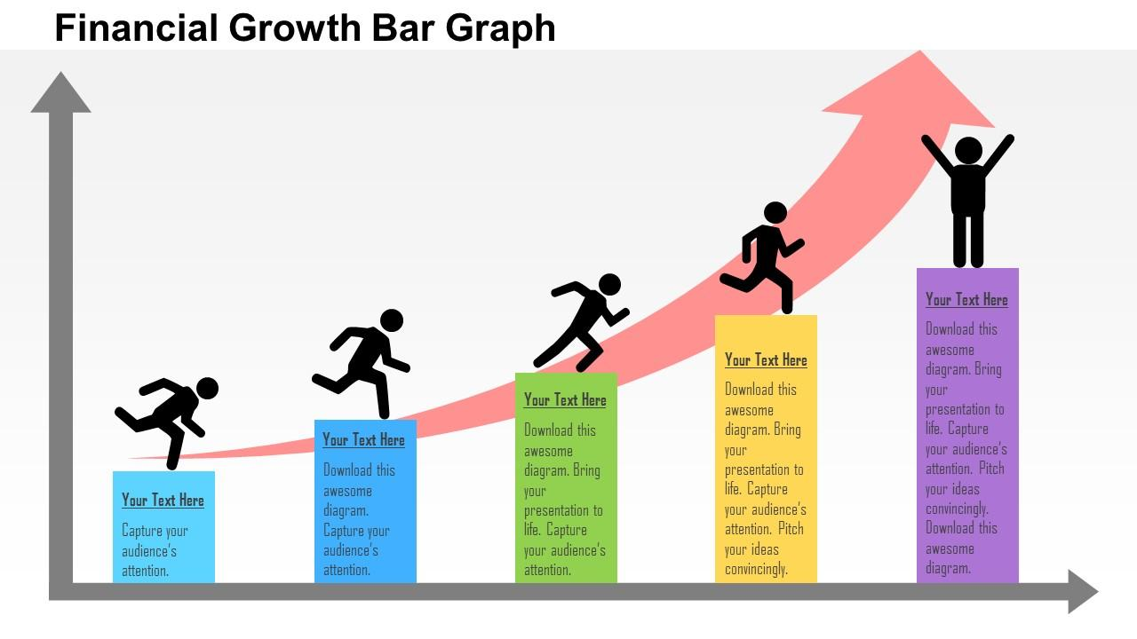








Financial Benefits
Cost Reduction Analysis
80-90% Cost Advantage
Staff Costs
3-5 Cr
Implementation Cost
2.5-4 Cr
vs 8-25 Cr
Stationery & Printing
20-40 Lakh
User Licensing
Unlimited
Documentation Storage
10-15 Lakh
Support
24/7 Dhaka
Reporting Manpower
15-25 Lakh
Customization
Built-in
Annual Savings
ROI Projection
BDT 5-8 Cr
Total Cost Reduction
Break-even Period
Annual Savings
12-18 Months
5-8 Cr BDT

Slide 22











Comparative Analysis
ULMS vs. International Solutions
ULMS Advantages
Implementation Time
4-6 months
12-24 months
Faster ROI: 12-18 months vs 24-36 months
Total Cost
2.5-4 Cr
8-25 Cr
Regulatory updates included
Bangladesh Compliance
Built-in
Customization Required
No hidden costs or surprises
24/7 support in local time zone
Local Support
24/7 Dhaka
Limited/Offshore
Key Differentiators
User Licensing
Unlimited
Per-User/Branch Fees
Training
Customization
Included
Flexible
Scalability
Updates
Unlimited
Regular

Slide 23














Implementation & Support
Implementation Methodology
Support & Maintenance
1
Planning & Requirements
2 weeks
24/7 Support
Dedicated Manager
2
System Configuration
4-6 weeks
3
Data Migration
2-3 weeks
Regular Updates
Hotfix & Patches
4
User Training
2-3 weeks
Security Monitoring
Performance Opt.
5
Testing & UAT
2-3 weeks
6
Go-Live & Support
Ongoing
Training & Documentation
Comprehensive user manuals
Video tutorials
Total Implementation Time
On-site training
4-6 Months
Train-the-trainer program

Slide 24
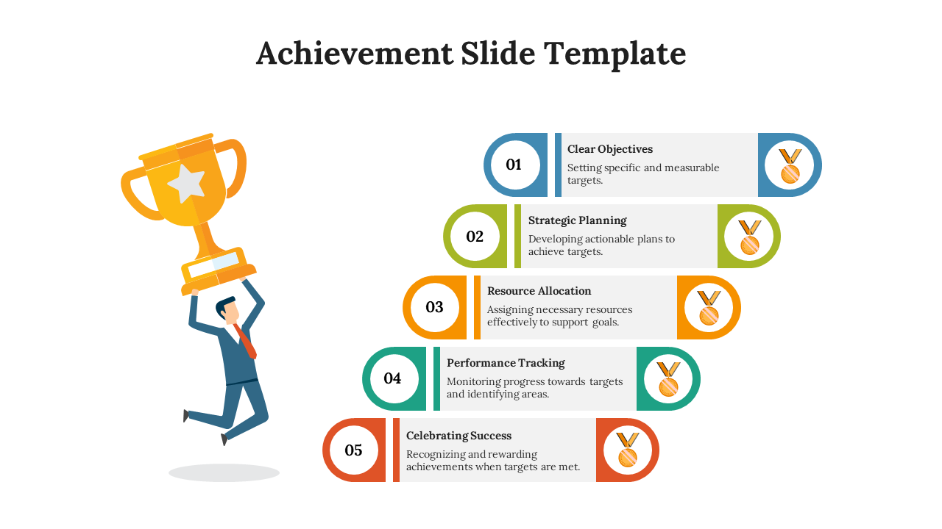





Transform Your Lending Operations with ULMS
85%
95%
90%
100%
80-90%
Faster Processing
Faster Decisions
Error Reduction
BB Compliance
Cost Advantage
Key Takeaways
Get Started Today
Enterprise-grade platform for Bangladesh's banking sector
Request Demo
Advanced AI-powered credit scoring
150+ APIs for seamless integration
Schedule Consultation
4-6 month implementation timeline
Get Implementation Proposal
24/7 Dhaka-based support
Contact Unisoft Systems Limited
info@unisoft.com.bd
© 2026 Unisoft Systems Limited. All rights reserved.

